Slide 1
Elucidat Experience modules How To Move from Selling to Building
The process at-a-glance and other time-saving items to help you build a successful online experience
February 18, 2020

Slide 2
High-Level Types
Elucidat samples to figure out the best approach
Interactive Storytelling
https://www.elucidat.com/showcase/#interactive-storytelling
Text-heavy content
https://www.elucidat.com/showcase/#learning-analytics-ebook
Gamification
https://www.elucidat.com/showcase/#sales-simulation

Slide 3
Top to bottom page scrolling
https://learning.elucidat.com/course/57a1feba70984-57c5963440c31
Single page view
https://www.elucidat.com/showcase/#making-policies-interesting

Slide 4
The Elucidat process
Wireframe / Site Mapping
Content Development
Look/Feel Development
Implementing + Programming
Review + Testing
Launch (Release)
High-level view of how the online platform will work.
Map out entry point/s; is there one? are there multiple based on population? Or is the entry point a list of questions to determine next progression?
How are the Page Types (short to sit on one screen? Page scrolling?
HotSpots? Page filps?
Surveys?
Knowledge checks?
How will the eLearning platform come to life in words
What’s the voice? The tone?
Will need to capture all internal/ external links noting where each hotspot/button will link to
2 drafts and a final
Once approved the content will move to the Implementation + Programming phase
How will the eLearning platform come to life in terms of client’s colors, fonts, design elements
No functionality at this point
1-2 look/feel options with edits to one chosen direction
Once approved the look/feel will move to the Implementation + Programming phase
Content approved
Look/feel approved
Building the eLearning platform
Internal review, testing, working through any errors, etc.
Client review, testing of all internal and external links
Other functional errors or items to adjust
Not the time for content or design look/feel changes
Upon approval we can launch the eLearning to meet the project end date
SCORM vs. online link
Need more points
Deliver
Site Mapping – what is it? How does it look? And what it’s not?
Creative online writing link to Elucidat video training (there’s one section dedicated to writing)
Look/feel phase
“Bringing it together” phase (content + look)
Programming phase
2 WEEKS | 3-6 WEEKS HAPPENING CONCURRENTLY | 2-4 WEEKS | 1-2 WEEKS | 2-3 DAYS

Slide 5
Building the Online Experience
Wireframe / Site Map

Slide 6
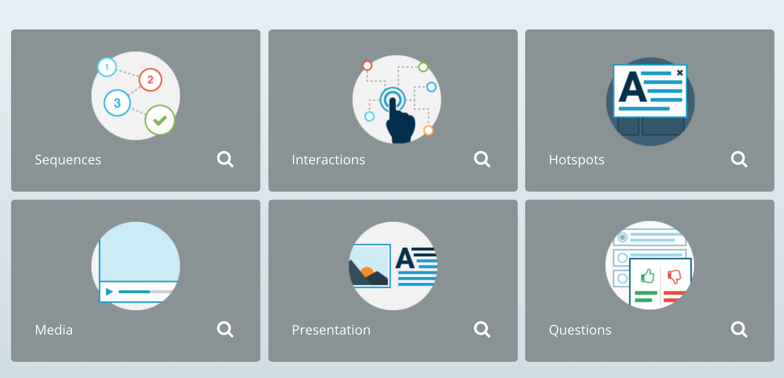
The parts needed to create your online experience
Knowing the terminology and how the full eLearning platform will come together will help build the wireframe more efficiently

Slide 7
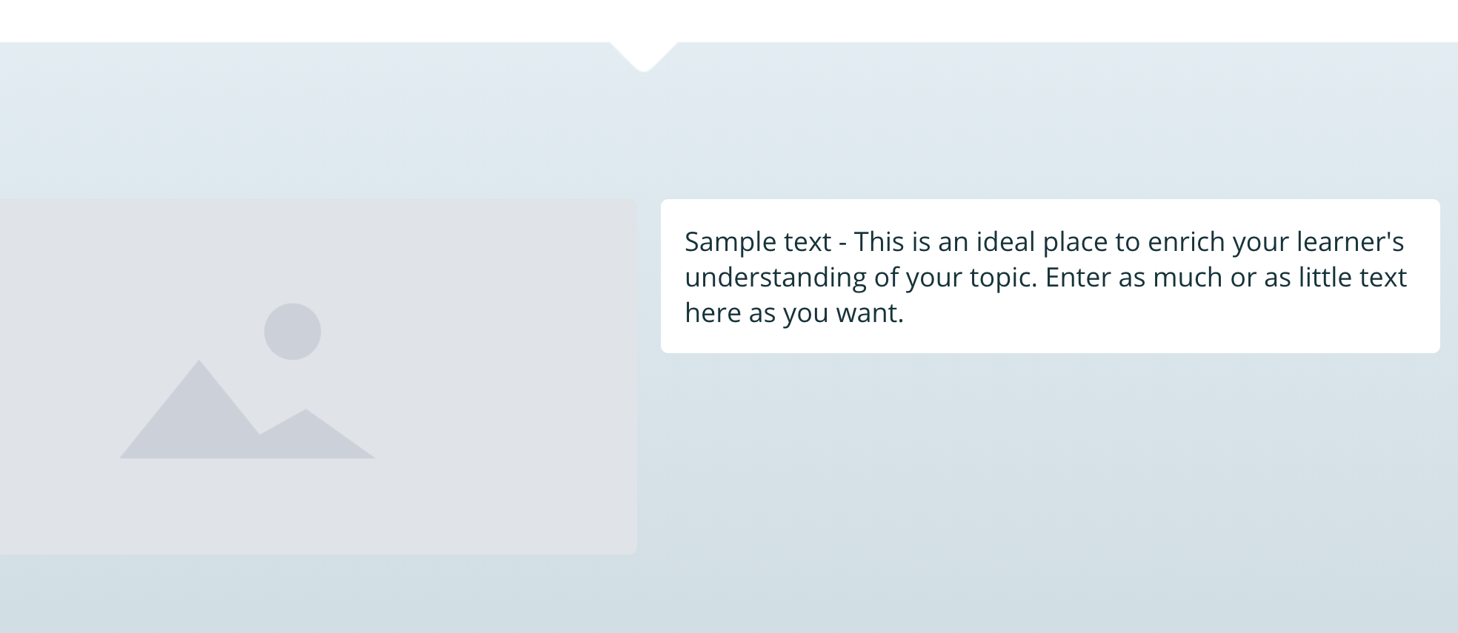
Presentation
Simple page type – Image + Text

Slide 8
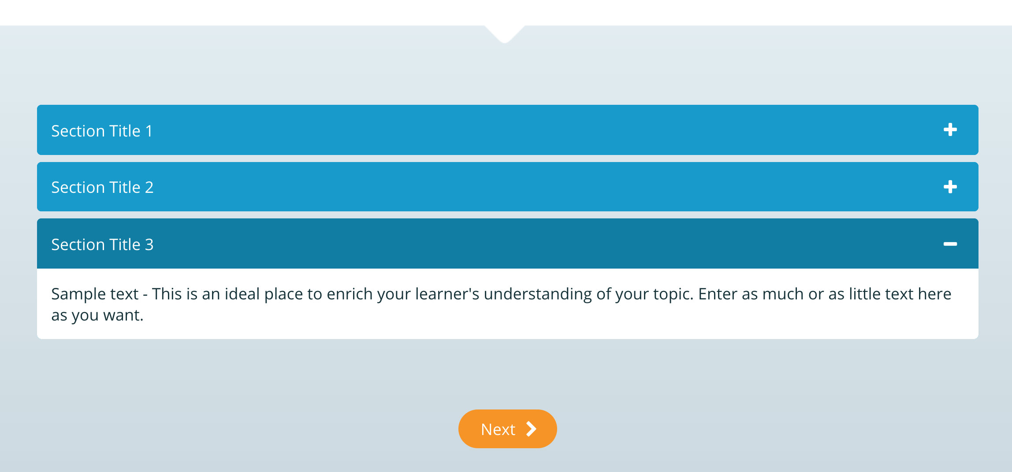
Sequence - Accordion
Pages where information is released in an order

Slide 9
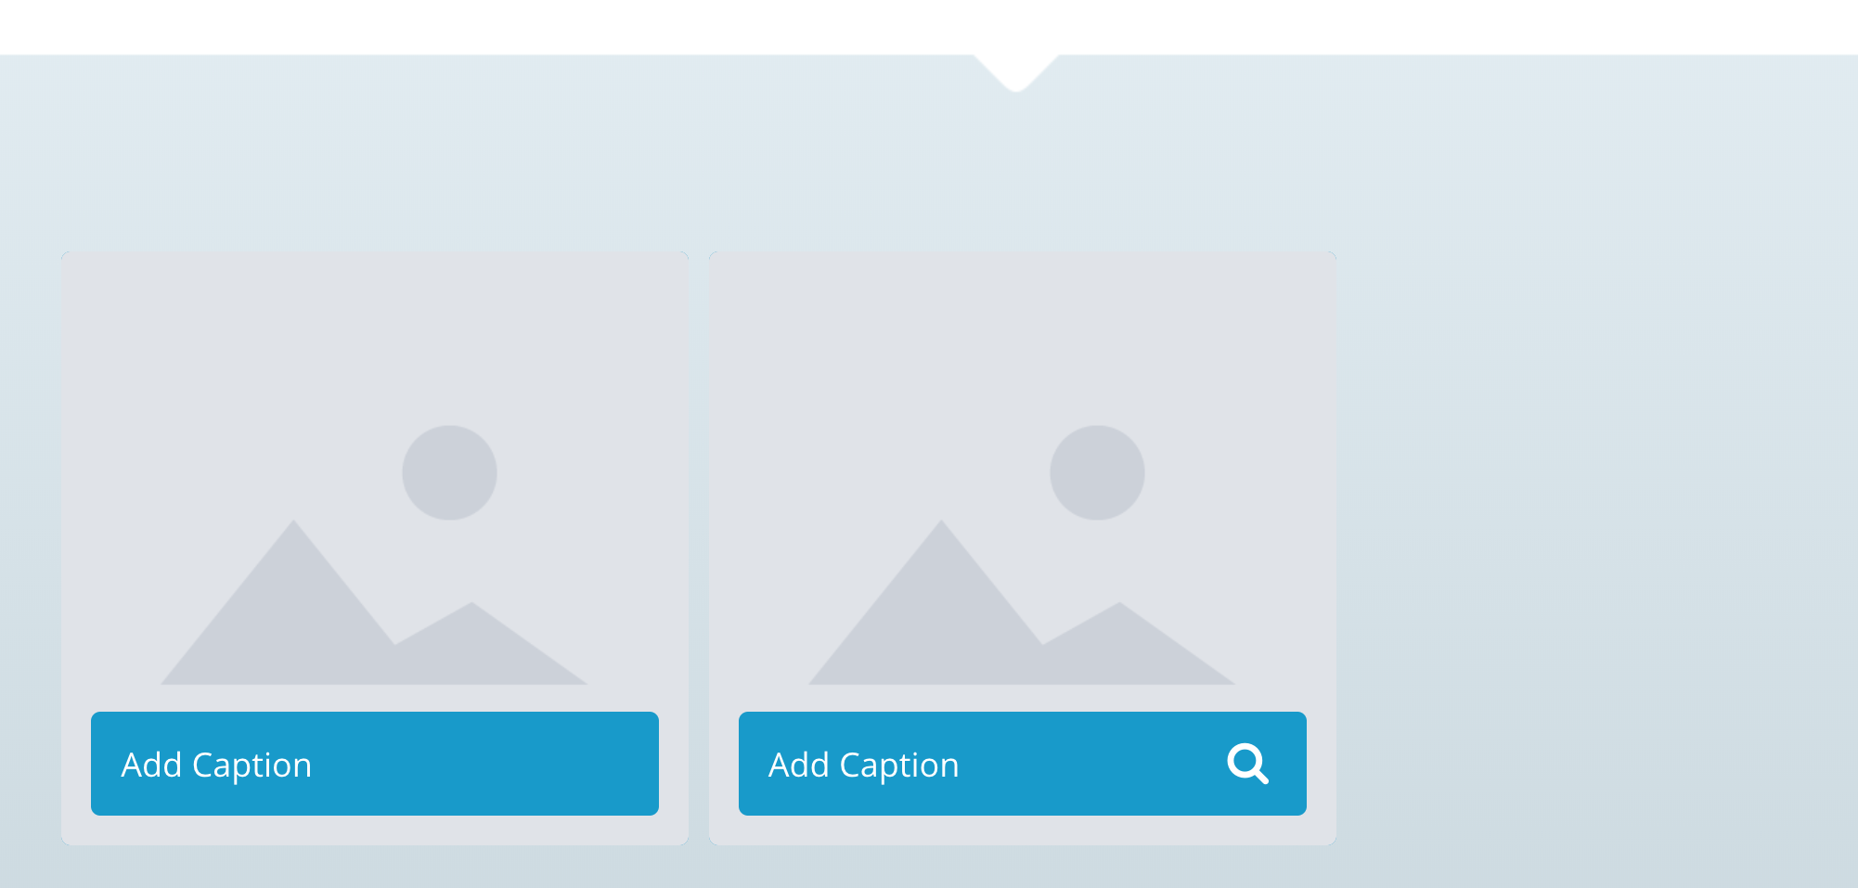
Sequence – Buildup
Pages where information is released in an order

Slide 10
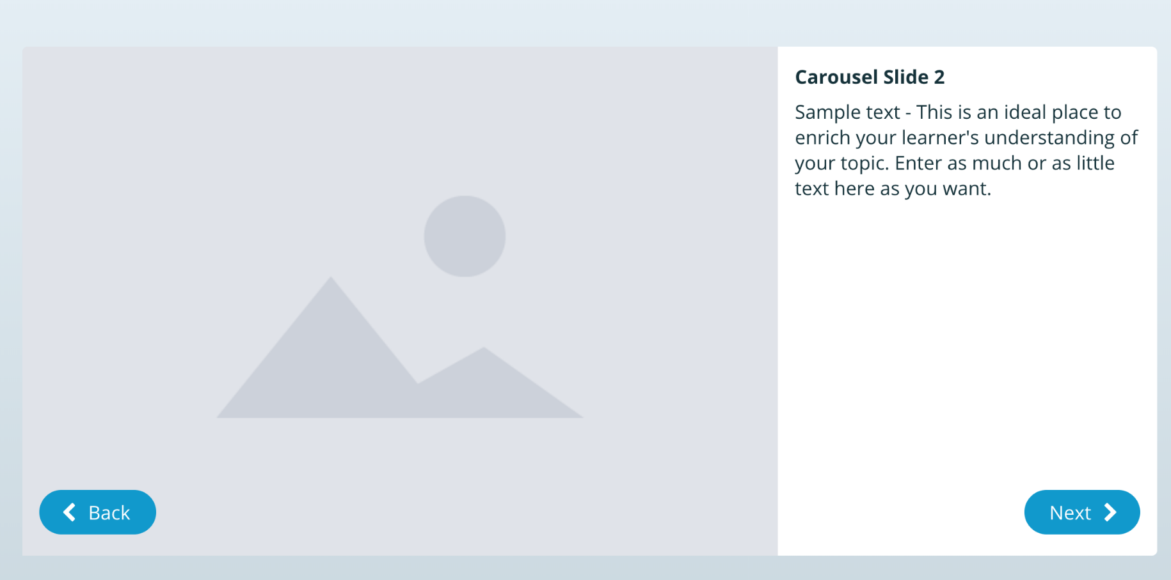
Sequence - Carousel
Pages where information is released in an order

Slide 11
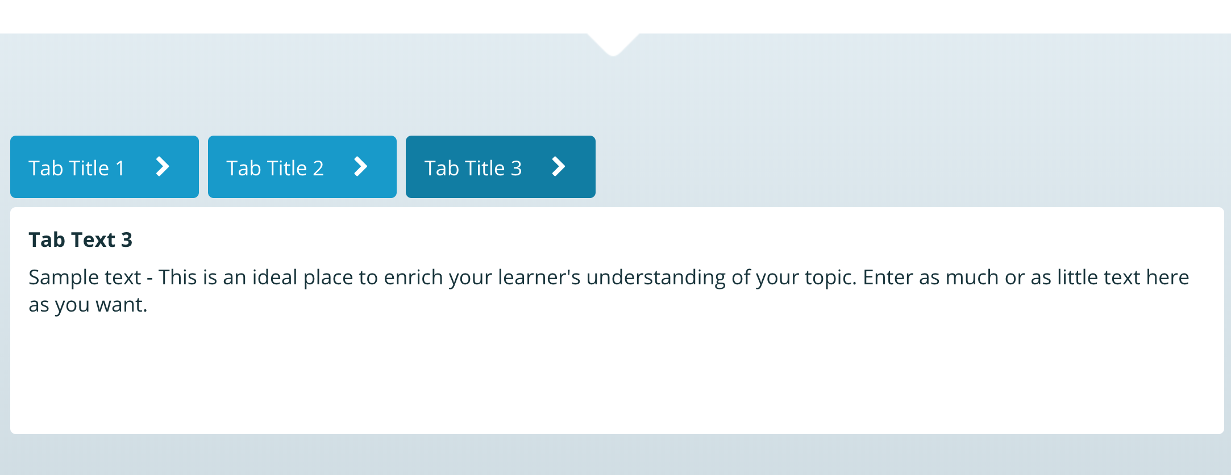
Sequence - Tabs
Pages where information is released in an order

Slide 12
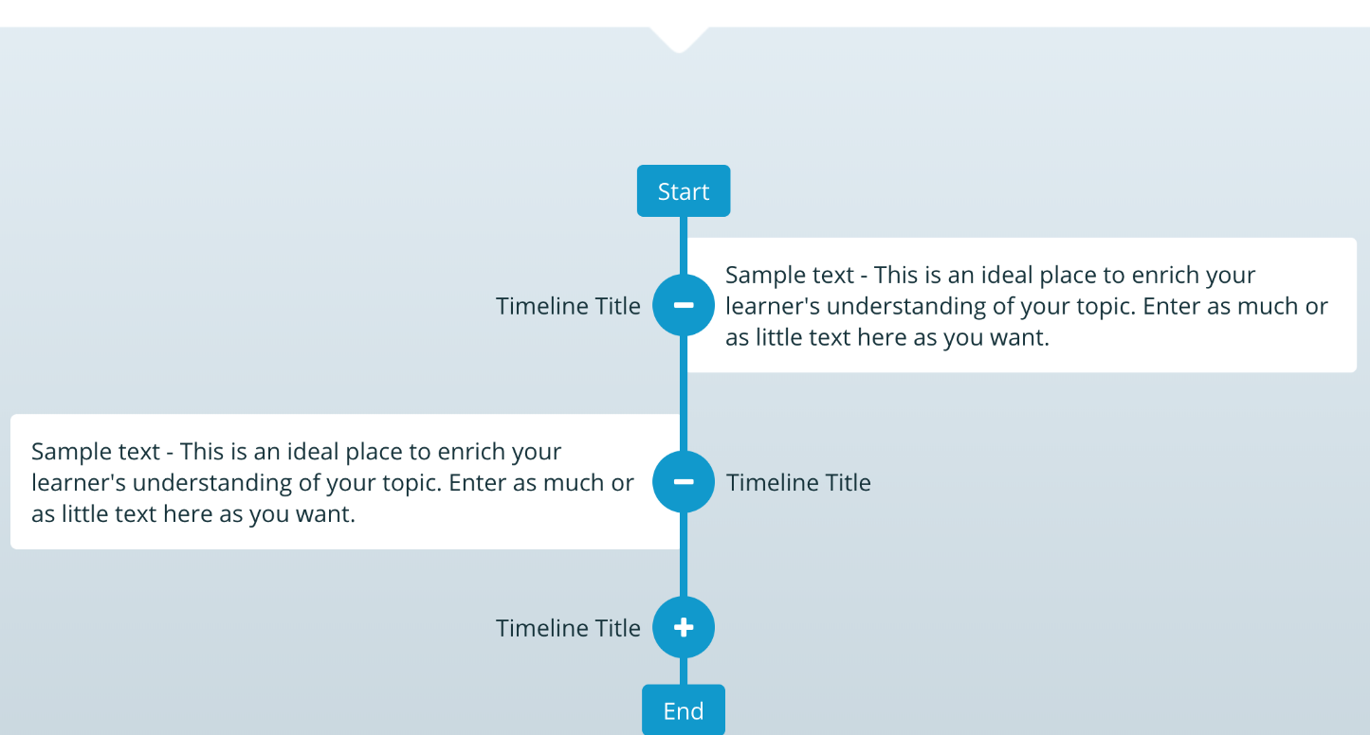
Sequence - Timeline
Pages where information is released in an order

Slide 13
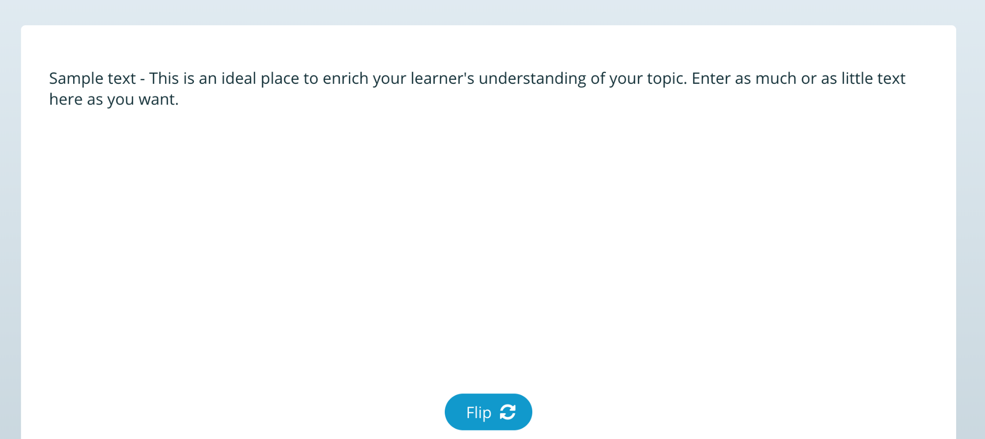
Interactions - Flipcard
Exercises that require the learner to interact

Slide 14

HotSpots – Image Explorer
Attention-getting element that sits on a page; popup window or button
Learner can click on these icons to get a content / popup box to appear

Slide 15
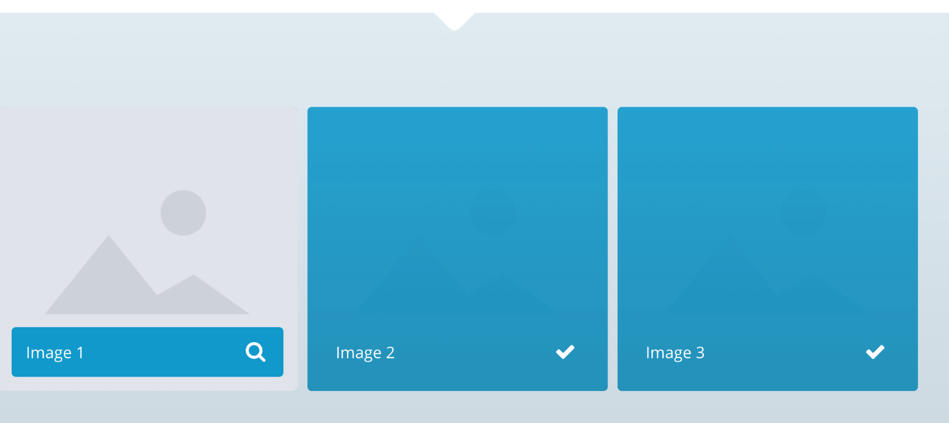
HotSpots – Image Grid
Attention-getting element that sits on a page; popup window or button
Learner can click on each box to get a content / popup box to appear. Checkmark will appear once learner has clicked and closed popup window.

Slide 16
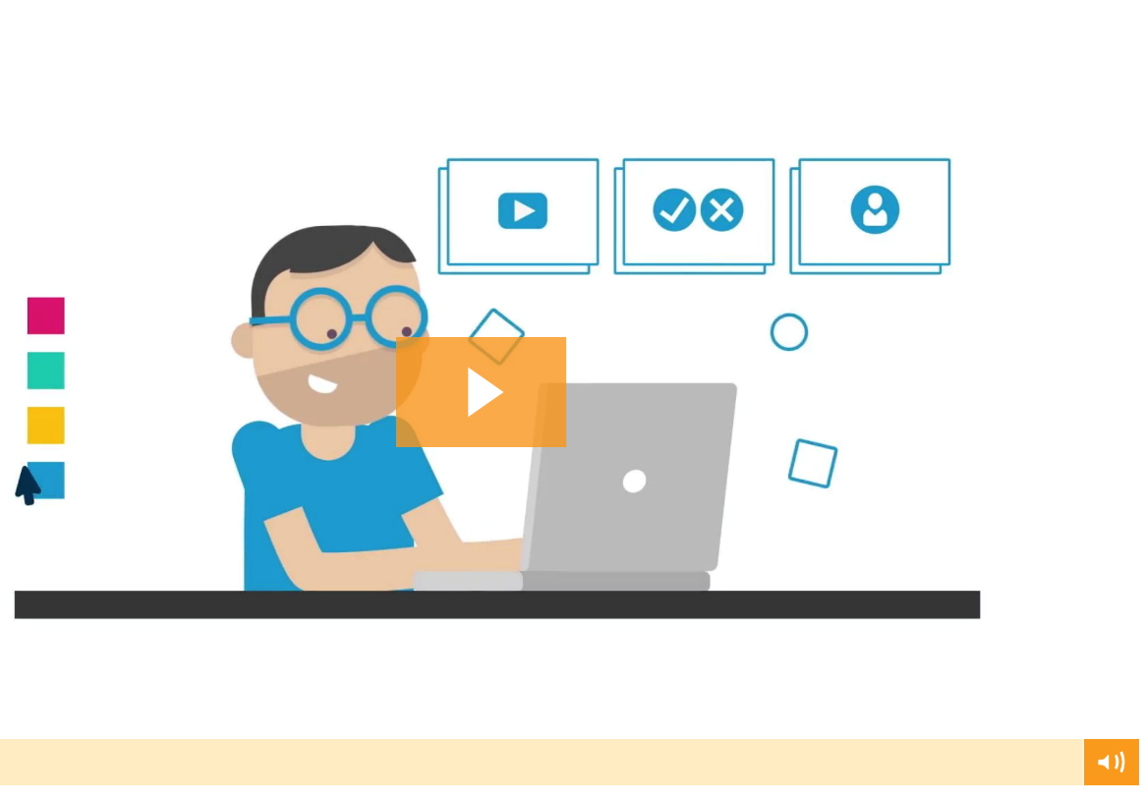
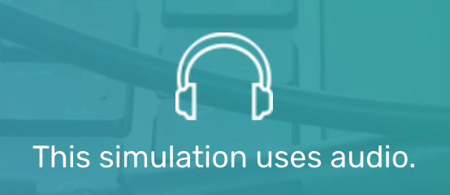
Media
Video, audio, branching video

Slide 17
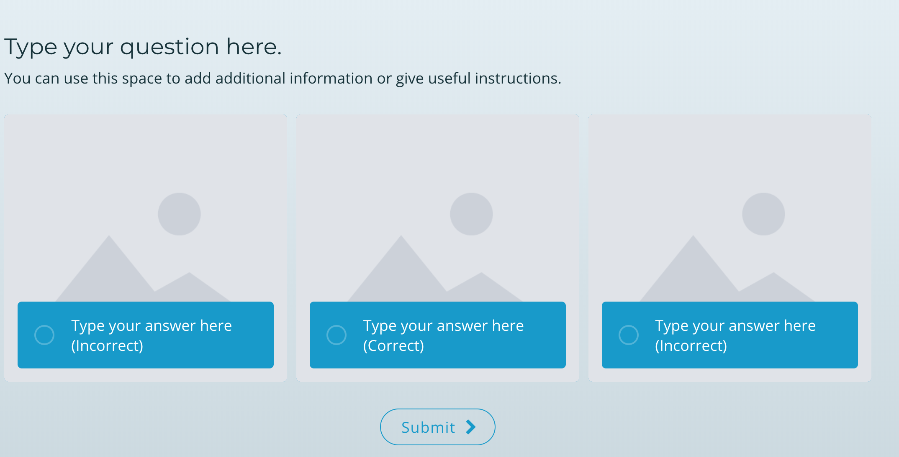
Questions – Image Grid (single or multi choices)
Assessments, Knowledge Checks & Surveys

Slide 18
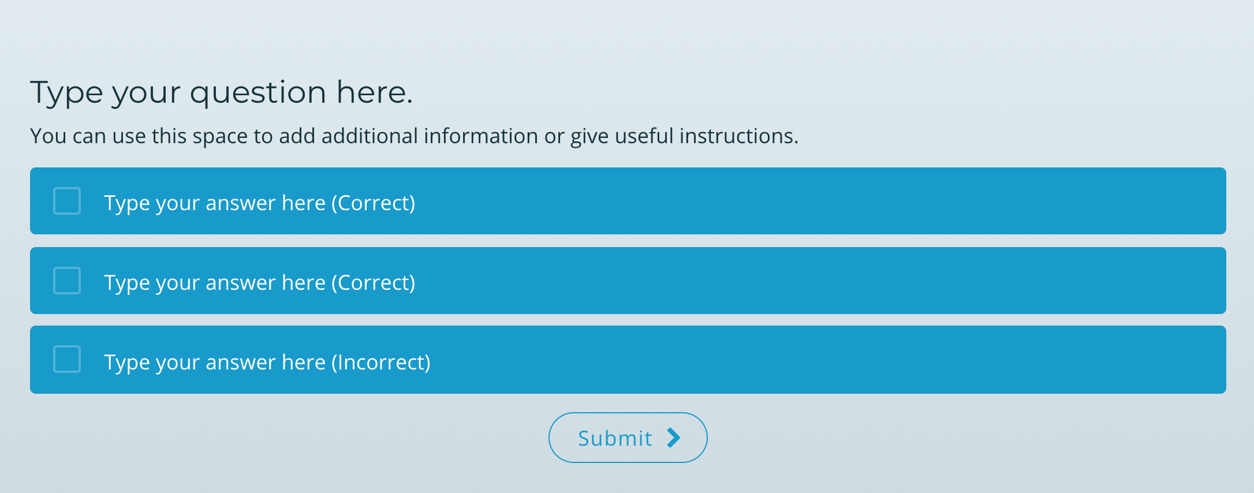
Questions – Multi-choice with Feedback
Assessments, Knowledge Checks & Surveys

Slide 19
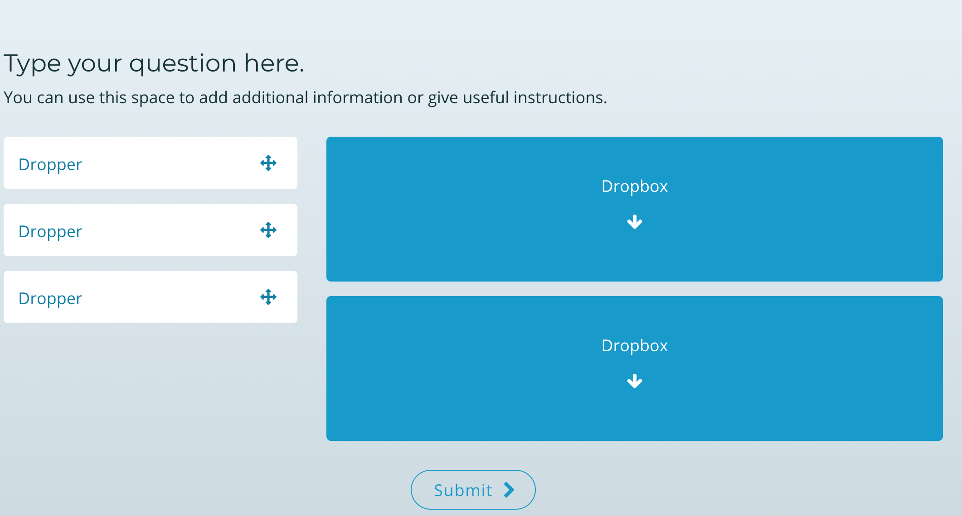
Questions – Drag Drop with Feedback
Assessments, Knowledge Checks & Surveys

Slide 20
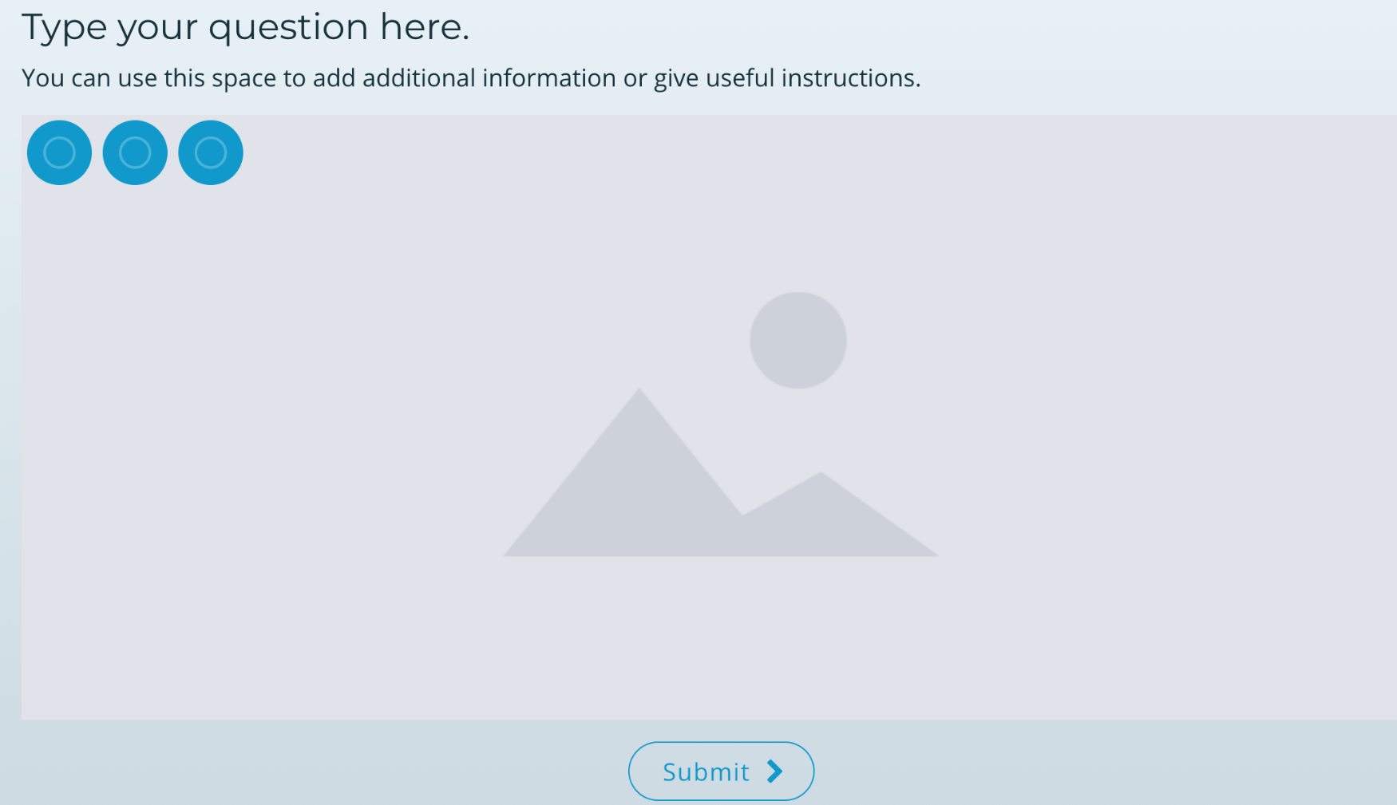
Questions – Image Explorer (single or multi choices)
Assessments, Knowledge Checks & Surveys

Slide 21
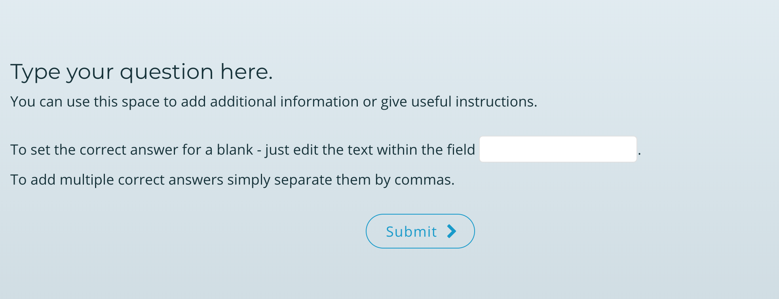
Questions – Fill in the Blanks
Assessments, Knowledge Checks & Surveys

Slide 22
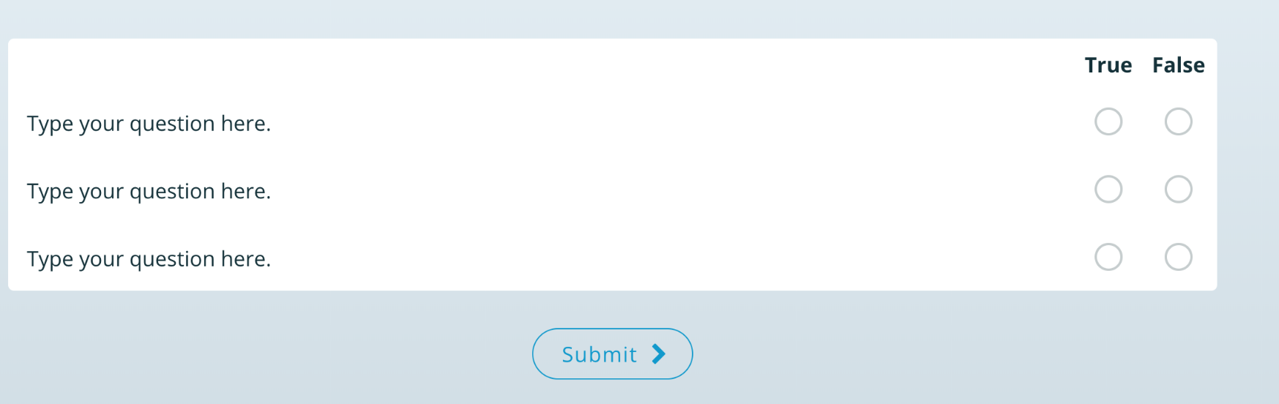
Questions – True / False
Assessments, Knowledge Checks & Surveys

Slide 23
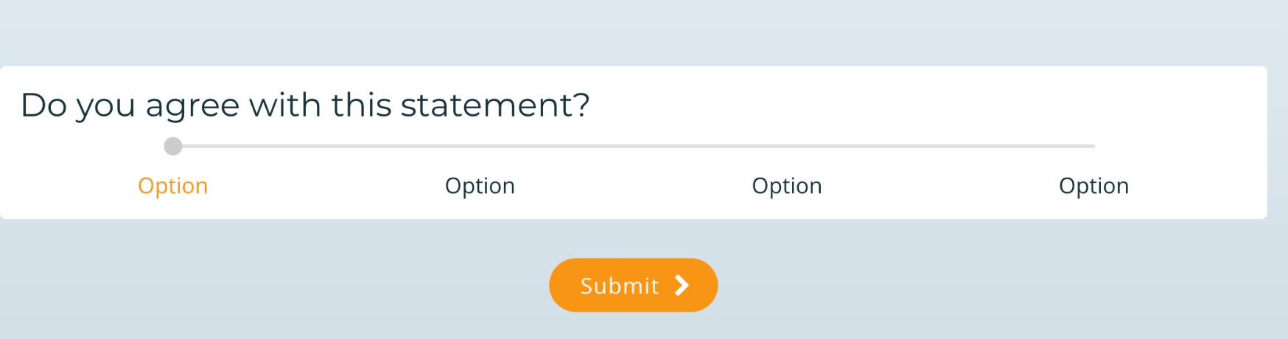
Questions – Likert
Assessments, Knowledge Checks & Surveys

Slide 24
PROJECT BRIEF
Project Brief Template

Slide 25
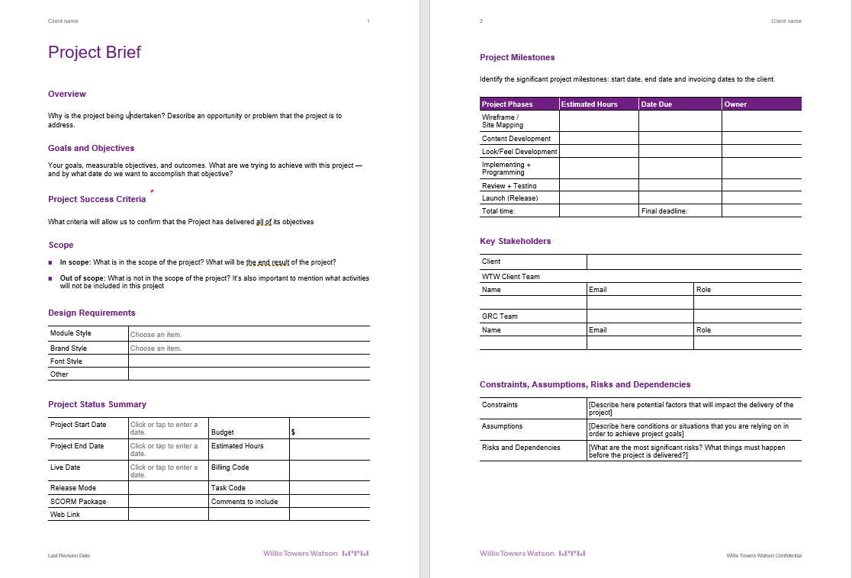
Project Brief

Slide 26
CONTENT WRITING

Slide 27
Content
Writing for the online experience
https://learning.elucidat.com/course/5829b13d0669e-5bd33790ac953

Slide 28
LOOK & FEEL DEVELOPMENT
CMG

Slide 30
Review + Testing
Best Practices

Slide 32
LAUNCH
Releasing your eLearning platform

Slide 33
SCORM vs ONLINE LINK
Notes on choosing appropriate release mode for a project
SCORM
ONLINE LINK
This release mode is most suitable for delivering content via an LMS.
Benefits of using this release mode:
You can use the Elucidat rapid-releasing feature to update content changes within minutes without the need to re-download and re-upload the zip package.
Using the Online SCORM release means you can include our powerful polling feature and clips features to encourage social collaboration and allow your users to see how peers have answered questions in your course.
Learner bookmarking (if your LMS allows it) so that learners are easily returned to the place they last visited in the course.
The traight back into the Elucidat analytics interface. This means yOnline SCORM release mode passes detailed user insights sou can capture heaps of additional analytics right from inside Elucidat, giving you even more detailed insights into how effective your content is and how it’s being utilised.
The zip file will include the imsmanifest.xml and launch.html files. All assets such as Images, Audio and Videos are held on the Elucidat servers. This means the content will be served quickly as the file is smaller and can be rapidly updated easily.
Choosing this mode will generate a unique URL for you to share with your users allowing them to access your course instantly.This release mode is most suitable for customers without an LMS or customers using an LRS.
Benefits of using this release mode:
You can use the Elucidat rapid-releasing feature to update content changes within minutes without the need to re-share the original URL with your users.
Using the Online Link release means you can include our powerful polling feature and clips features to encourage social collaboration and allow your users to see how peers have answered questions in your course.
Learner bookmarking so that learners are easily returned to the place they last visited in the course.
Using both Online Link release mode and our learner identification feature, means you’ll get detailed user insights sent straight back into the Elucidat analytics interface. This means you can capture heaps of additional analytics right from inside Elucidat, giving you even more detailed insights into how effective your content is and how it’s being utilised.
Your content is hosted on our servers meaning you don’t need to download a file or have an LMS to host your content. The link can easily be shared and also embedded on a webpage via an iFrame to give you even more options for reaching your users.

Slide 34
Data Analytics

Slide 36
Appendix

Slide 37





Creating the optimal experience through an online platform
A successful project will…
Define and support the full employee online learning experience
Engage employees through interactivity
Articulate expected outcomes and testing timeframes
Connect content and learning parameters with a consistent visual identity
Integrate with other corporate communications

Slide 38
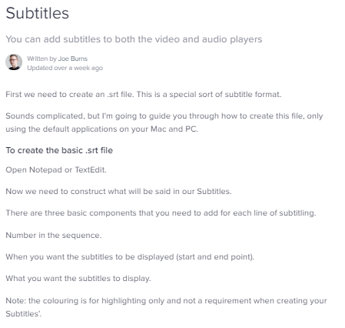
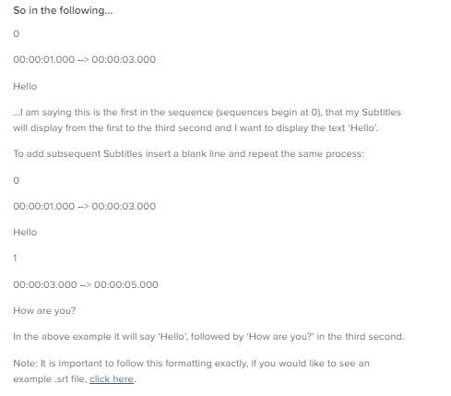
Adding Subtitles

Slide 39
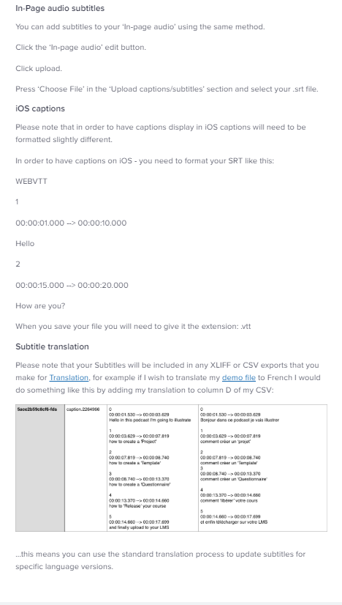
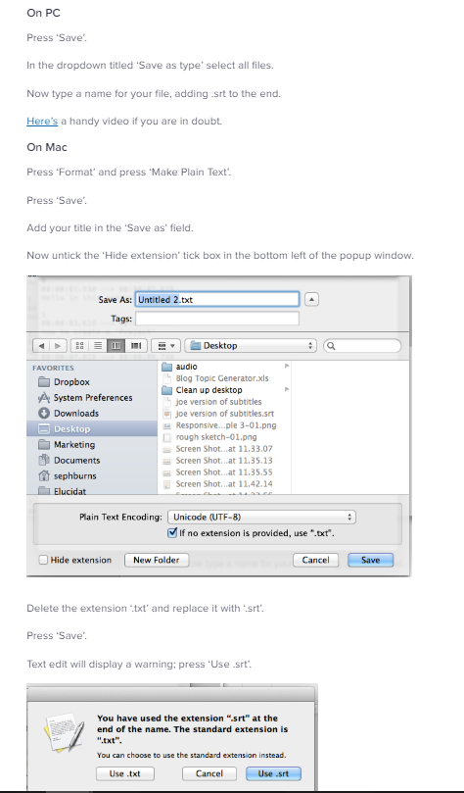
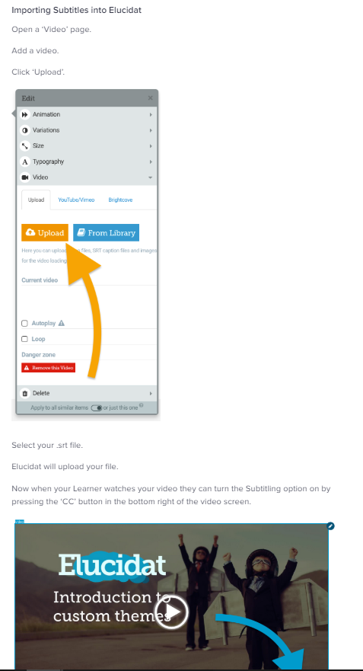
Adding Subtitles

